Slide 1
Welcome to our presentation
Topic : Customer Loan Analysis
Name : Showmika Jahan Oushi
Roll: 02

Slide 2

Abstract
Bank loans are crucial for economic growth, providing capital for personal needs (education, healthcare, homes), business demands (working capital, expansion), and government projects. Factors like inflation, rising costs, and financial emergencies increase loan demand. Financial literacy, credit access, and interest rates influence borrowing behavior, impacting the banking sector’s stability.

Slide 3
Introduction
Bank loans are essential for individuals, businesses, and governments, funding capital investments, personal needs, and economic growth. Businesses seek loans for expansion, while individuals finance homes, education, or emergencies. Economic conditions influence borrowing, and insufficient savings drive loan demand. Understanding these causes helps banks create effective lending policies, supporting financial stability and economic development.

Slide 4
Data Analysis
Credit Risk Assessment
Fraud Detection
Portfolio Optimization
Regulatory Compliance
Economic Factors
Improved Decision-Making
Loan Recovery Strategies
Customer Segmentation
Profitability and Revenue Maximization
Early Warning Systems

Slide 5
Methodology
Regulatory Requirements
Credit Risk Management
Economic Conditions
Market Competition
Bank's Internal Policies
Customer Profile and Behavior
Technological Advancements
Collateral and Security
Cultural and Social Factors
Globalization and Cross-Border Lending

Slide 6
Research Question
A research question defines the focus of a study, guiding investigation and analysis. It should be clear, specific, and achievable, aligning with research objectives. Research questions can be open-ended for qualitative studies or specific for quantitative research. A well-formulated question ensures relevance, methodology direction, and meaningful knowledge advancement.
1) How much customer are taking are short term loan?
2) what is the average current loan amount for long term loan versus short term loans?
3)Is there a correlation between annual income and credit score?
4) what is the average credit score for customer with Rent versus own home?
5)how does monthly debt vary with the years in the current job?
6)What is the total count of credit scores across all purpose?

Slide 7
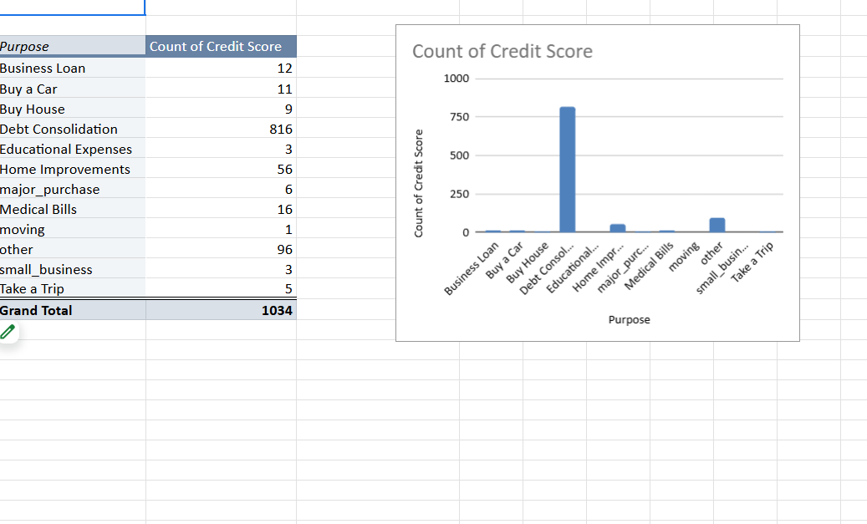
Result
Debt Consolidation is the primary purpose for loans in this dataset, likely due to its widespread appeal for refinancing or managing existing debts .Other purposes, such as Home Improvements and Medical Bills, show some significance but are far less frequent.Minimal counts for categories like Small Business and Take a Trip suggest these are less common reasons for obtaining loans. This analysis highlights loan purpose trends and their relationship with credit score distribution.

Slide 8
Conclusion
The study highlights key factors driving bank loans, with debt consolidation being the most common reason, helping individuals manage high-interest debts. Homeownership, medical emergencies, and personal aspirations also influence borrowing. Loan approval depends on job stability, credit scores, and loan terms. Understanding these factors enables banks to refine loan offerings effectively.

Slide 9
Thank You

